Slide 1
StockOverflow
A Bits Plz Special.

Slide 2
Special Thanks to Our Sponsors.

Slide 3
Unofficial Sponsors

Slide 4
Simply put, what is StockOverflow?

Slide 5
Seems Kind of Simple Right?

Slide 6


Slide 7
Let Me Explain…

Slide 8
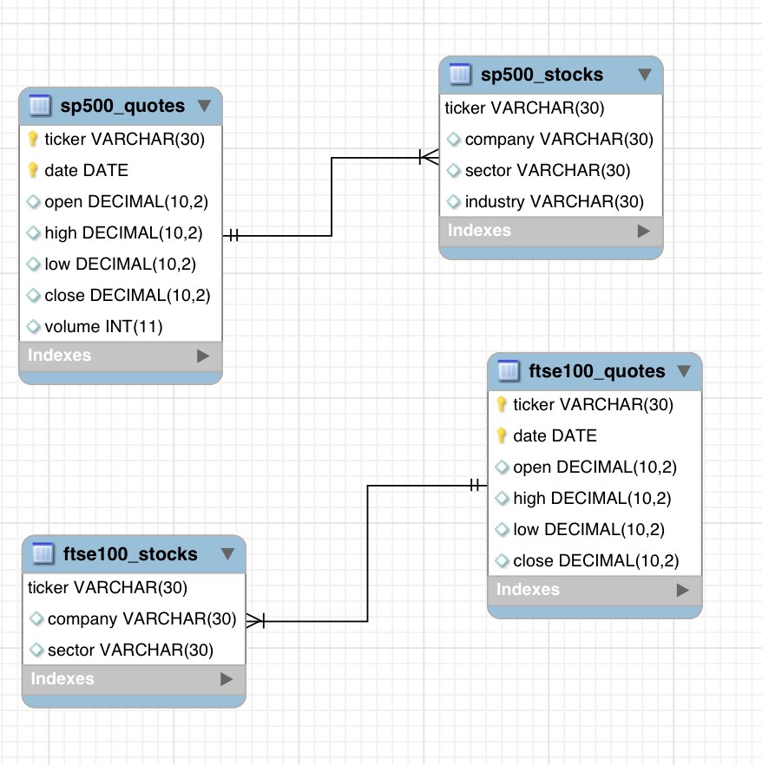
Some Technical Stuff.

Slide 9
Gather Data, Real-World Data. How & What?

Slide 10
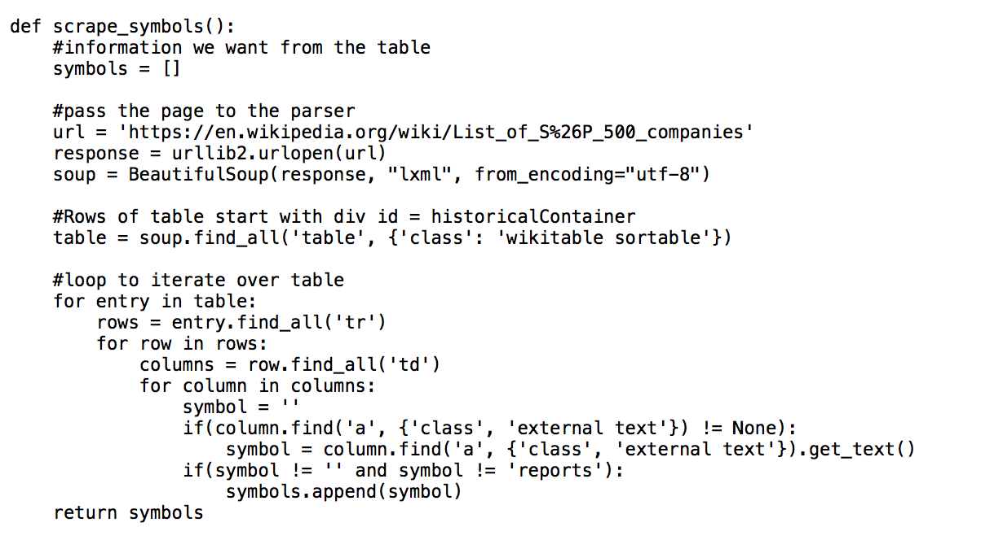
Some Code.

Slide 11
50k Tuples?

Slide 12
Putting It All Together.
And Our Demo.

Slide 13
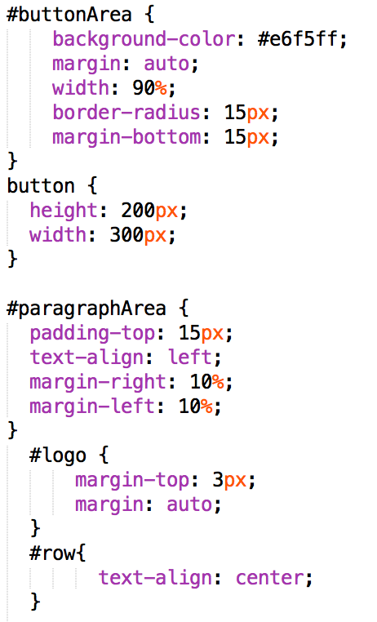
Front-End Dev.

Slide 14
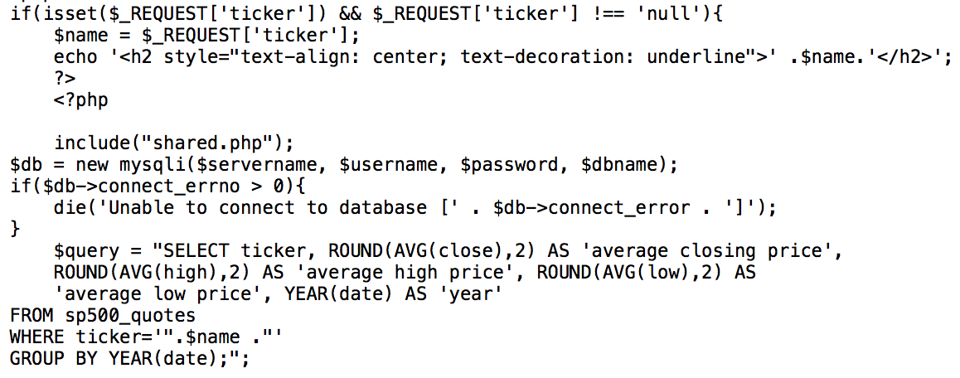
Back-End Dev.

Slide 15
The Process.

Slide 16


